Slide 1


Mapping Japanese Landscape Prints with NLP:
Challenges and Solutions
EWA MACHOTKA, Stockholm University
KONSTANTINA LIAGKOU, Athens University of Economics and Business
JOHN PAVLOPOULOS, Athens University of Economics and Business, Stockholm University
Notes:
Ewa: Good morning and good afternoon! I am Ewa Machotka, Associate Professor of Japanese Art History from Stockholm University. I also represent our research team that includes Dr. John Pavlopoulos, and Konstantina Liagkou. Today, we will present the results of the first phase of our project on mapping Japanese early modern landscape prints through Natural Language Processing tools, focusing on challenges and solutions inherent to this type of interdisciplinary study. By mapping, we mean geolocating on a map for network analysis, following how the concept is used in the Humanities and the Digital Humanities.

Slide 2

CONTENT
01
Introduction
THE RATIONALE OF THIS PROJECT
Corpus related challenges
UKIYO-E LANDSCAPE PRINTS
02
03
Methodology
METHODS AND DATASET
Empirical results
EVALUATION METRICS FOR NER
04
05
Conclusions
LIMITATIONS, FUTURE WORK
Notes:
First, we will explain the rationale of this project, introduce our corpus, namely landscape prints. Then, we will present methodological challenges related to the study of our data; and our experiments with the use of named entity recognition, or NER in short. Lastly, we explain the limitations of our study and our future research plans.

Slide 3
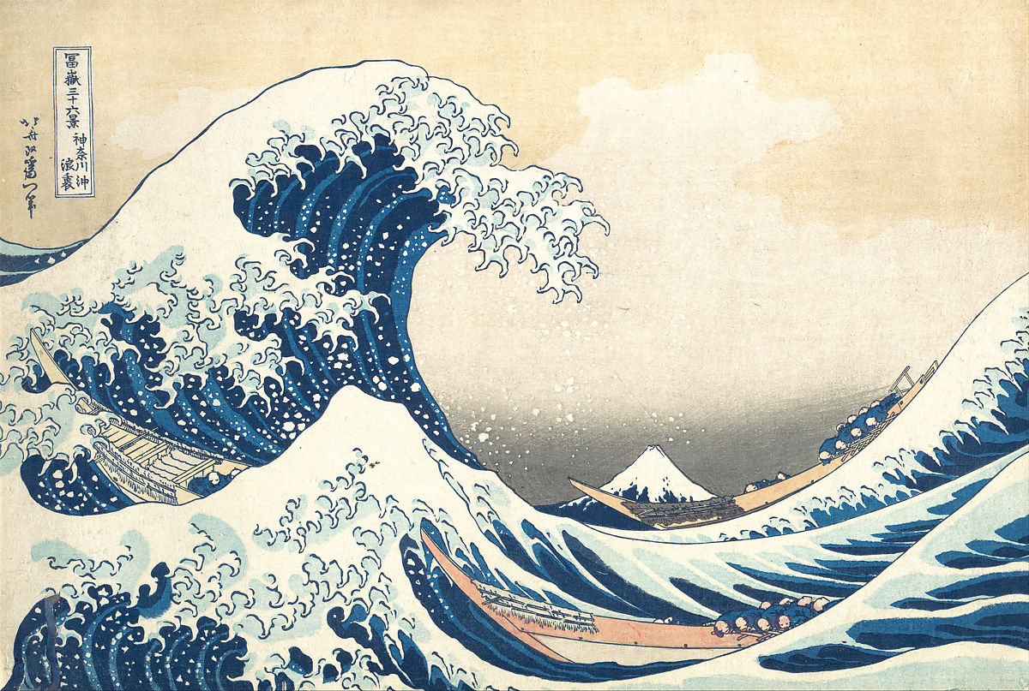
The rationale of this research project
Katsushika Hokusai (1760-1849)
神奈川沖浪裏​​
“Under the Wave off Kanagawa”
from the print series 富嶽三十六景 “Thirty-six Views of Mount Fuji” ca. 1830–32, MET.
Notes:
First, the rationale for this project. Japanese early modern woodblock prints, so-called ukiyo-e or ‘pictures of the floating world’ were produced between the seventeenth and mid-nineteenth century. Landscape prints like this one are the most popular genre. The problem is that their understanding is shaped by Western modern epistemologies of landscape that may not be well fitted for the analysis of pre-modern non-Western artefacts.
Originally Japanese images were not called landscapes (or fuukei) but meisho-e (pictures of famous places) rooted in poetic rhetorical figures that tie seasonal images with particular (real or imagined) places. So, to understand these images and their social function (to what extend they represent physical places), we need to understand their relationships with actual topography. As the corpus is rich and diverse we propose that so-called ‘distant viewing’ or macroanalysis of visual materials (Taylor and Tilton 2019), has a potential in this context.

Slide 4
Research Questions
What kind of places are depicted in ukiyo-e prints and what places are not featured in the images?
How are these places distributed across Japanese territory?
Notes:
We conducted a large-scale mapping exercise to see: 1) What kind of places are depicted (and are considered significant)? 2) How are these places distributed across Japanese territory? 3) How do these constellations of places change depending on time, artist, publisher, format etc. This is of course a very complex task so today we’re presenting the results of the first stage of our ongoing research. The next stage is to extend the scale of this study, by distant viewing tens of thousands of un-transcribed prints. In this case, NER will be applied on HTRed, and not human-transcribed, text. Hence, we want to minimise HTR errors, which connects us with the previous day of the workshop.

Slide 5
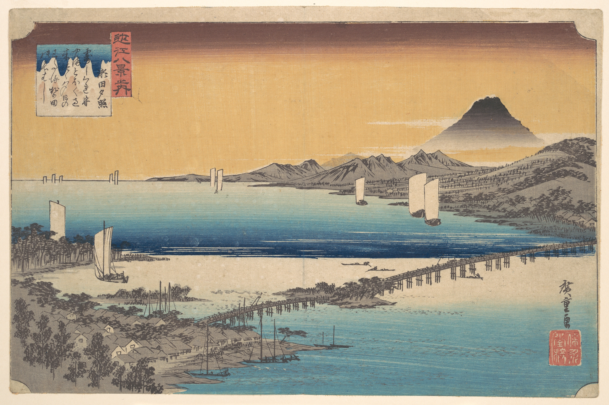
Meisho-e landscape prints: Research challenges
Utagawa Hiroshige (1797-1858),
瀬田夕照 (Sunset Glow at Seta),
from the print series
近江八景之内 (The Eight Views of Ōmi, 1834-35), multicolour woodblock print, MET (OA).
Notes:
The field of Spatial Art History combining Geographical Information Systems (GIS), Natural Language Processing (NLP) and Corpus Linguistics, have advanced in the past years. However, although these tools perform well on modern datasets it is not the same for historical materials. We can encounter several problems such as place reference identification and and place reference disambiguation (related to language changes over time), OCR errors as well as the association of geospatial information related to ambiguity in language use (e.g. places sharing the same name), or related to changes in administrative geography. The situation is even more complicated in the case of mapping meisho-e prints due to the ambiguity of the depicted visual motives.
Place identification in prints is not facilitated by visual motives but by the image-content related inscriptions printed in the images that often feature place names or meisho (lit. famous places). So, geolocating of meisho sites requires reading of inscriptions. So, transcription of inscriptions is one of the main obstacles for art historians interested in a large-scale analysis of the prints. This is due to complexity of the Japanese early-modern writing system, adequate identification of place names, and material aspects of a print.

Slide 6
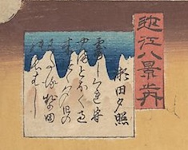
Challenge 1: Complexity of the Japanese early-modern writing system
Two cartouches in the upper left corner:
red cartouche features the title of the print series 近江八景 Ōmi hakkei (The Eight Views of Ōmi) written with kanji characters,
square cartouche features the title of the print 瀬田夕照 Seta no sekishō (Sunset Glow at Seta River) with the place name 瀬田 Seta (Seta River), and a poem related to this place: rendered in kanji and phonetic hiragana syllabary,
Inscriptions written in kuzushiji cursive script
Notes:
Contemporary Japanese writing system consists of three types of characters: two syllabaries of 46 basic characters and ca. 50,000 logographic kanji characters, of which ca. 2,000 are used today. These scripts are used interchangeably in one text; and text is written without spaces between words.
The inscriptions on ukiyo-e prints are rendered in so-called kuzushiji cursive script used before the 20th c. Reading kuzushiji is challenging for both humans and machines due to the use of hentaigana or ‘kanji variations’ in which kanji could be used alternately depending on their phonetic value. Also, the layout of texts is characterized by a variety of spatial distribution across the page. Therefore, the application of OCR software has been challenging.
Recently we noted progress. The new tools such as KuLA (Kuzushiji Learning Application) (Hashimoto), KuroNet and Miwo (Clanuwat) and newly established databases facilitated progress in the field of automated data harvesting from Japanese pre-modern textual sources. But work is still in progress.

Slide 7
Challenge 2: Material aspects of the print
Two cartouches in the upper left corner:
square cartouche with a complex multicolor background presents a poem on 瀬田夕照 Seta no sekishō (Sunset Glow at Seta River) :
つゆ時雨もる山遠く過き來つゝ夕日のわたる勢多の長はし
‘The long bridge at Seta River, over which crosses the setting sun, passing far beyond the mountains, dripping with autumn dew’
Notes:
The inscriptions on multicolor woodblock prints pose another challenge for OCR/HTR software. The success of the respective system depends on the quality of datasets e.g. quality of the scan as well as the visual characteristics of the original woodblock print such as its color scheme, background for inscriptions, preservation state (physical damages).

Slide 8
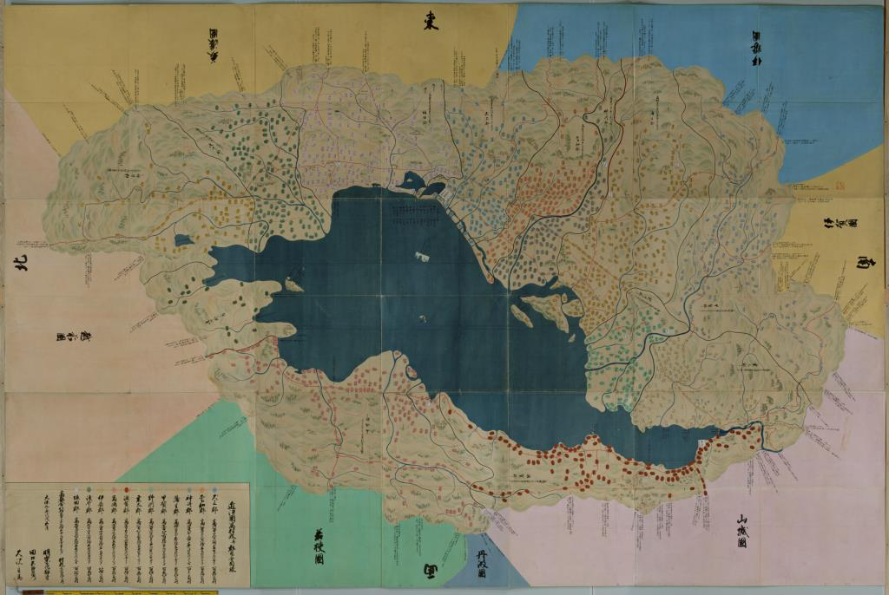
Challenge 3: Adequate identification of place names
AN, 近江国絵図 Ōmi kuniezu (Map of Ōmi Province), 1836, color on paper, 337 x 511 cm, National Archives of Japan
Notes:
The historical place-names extracted with NER from meisho-e inscriptions are not easily geolocated on contemporary maps of Japan due to historical transformation of Japanese writing systems, and historical changes in administrative geography in Japan as the retrieval algorithms are trained on contemporary datasets and gazetteers of toponyms (place names). The problem is unavailability of a comprehensive digital gazetteers of Japanese historical geographical names. The Gazetteer of Japan issued by the Government of Japan does not cover historical toponyms. Some scholars experimented with mapping historical places and used curated data (manually annotated data) that are converted to the gazetteer. The problem is disambiguation of toponyms in texts (as they may refer to different places) e.g. a similar type of natural formations (e.g. Takayama 高山 > lit. ‘High Mountain’) can be found in different parts of Japan.

Slide 9
Challenge 4: Recognising system-transcribed inscriptions
(a) Minimise system-transcribed errors
E(HTR) → E(NER)
(b) Assess the sensitivity of NER on HTR errors
Notes:
The inscription is characterized by a variety of spatial distribution across the page, placed inside of a cartouche or outside it with multicolor backgrounds, increasing the difficulty level for the recognition software. The transcription errors are inevitable, so two questions arise: (a) How do we minimise the system-transcribed errors, so that we minimise the propagation of any errors to the recognition phase that follows, (b) how sensitive is NER on the HTR errors?

Slide 10
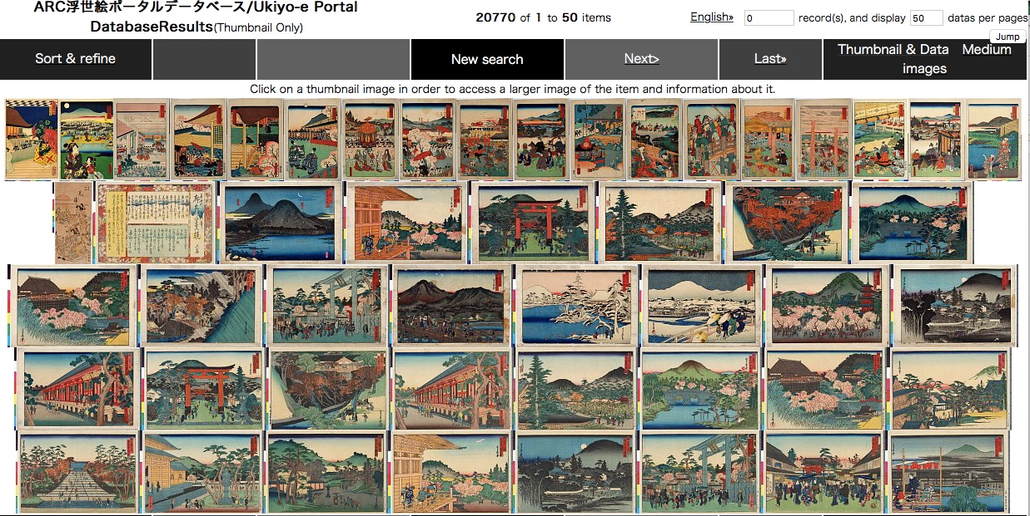
Dataset development
Over 20,408
Ukiyo-e prints
200
Annotated
by an art historian,
expert in Japanese
early modern history
469
Place names
in the print
inscriptions
Ukiyo-e Portal Database, Art Research Center, Ritsumeikan University, Kyoto
Notes:
To conduct ‘distance viewing’ of images we of course needed data. Fortunately, the access to the data for this work was facilitated by the database hosted at the Art Research Centre at Ritsumeikan University, Kyoto. The centre’s digital databases of Japanese printed culture hosts approx. 700,000 (678,429) prints kept at 28 institutions in Japan and abroad. Our study investigated approx. 20,000 (20,408) digitized prints featuring natural environments, issued around 1800-1850s. From the around 20,000 digitized prints which arose from our search based on the keyword ‘meisho’ (famous place) and ‘meisho-e’ (image of a famous place), we randomly selected 200 samples to annotate and use them to train and test machine learning algorithms to extract place-name entities. An art historian, an expert in Japanese early modern history annotated two sets of images (100 images each) identified through random sampling and after annotation we identified 469 place names tags.

Slide 11
Dataset development
Inter-annotator Agreement (ΙΑΑ)
Micro-averaged Cohen’s kappa
Tags for place-names
Annotations
1
LOC (Location)
Places that were less-easily pinned on a map (e.g. roads, mountain ranges)
42.97%
104
.
78.63%
2
GPE (Geopolitical)
Places that were possible to be pinned on a map (e.g. names of cities, temples, shrines, bridges)
365
78.80%
3
PLACE
All places, merge LOC and GPE
469
Number of tags
Notes:
[CAN BE SKIPPED] > yes, let’s skip it
The annotation process was guided by two major principles.
click: First, all places that were possible to be pinned on a map (e.g. names of cities, temples, shrines, bridges) were annotated as GPE and we detect 365 GPE tag.
click: Second, places that were less-easily pinned on a map (e.g. roads, mountain ranges) were annotated as LOC with 104 tags.
click: A second annotator annotated the inscriptions of 20 randomly prints of the already annotated sample to perform inter-annotator agreement.
After calculating the micro-averaged cohen;s kappa, we found that two annotators agreed by 42% for LOC
click: and agreed much more on GPE, with around 78.6% cohen kappa. As we can see here, to annotate the inscriptions with GPE and LOC tags was very difficult for the experts, let alone for a machine learning model that can learn only the annotation provided by an expert.
click: Thus, we decide to merge the GPE and LOC to a single tag, with name, PLACE. This, increase the results of inter-annotator agreement to 78.8%

Slide 12
Methodology
42.97% -> LOC
NER to identify place-names (LOC & GPE) in inscriptions on ukiyo-e
Used 100 prints to evaluate the NER models
Precision Recall F1-Score
Computed Cohen kappa for inter-annotator agreement
78.63% -> GPE
1
3
5
2
4
6
Used 100 print to fine-tune pre-trained spaCy and Bert models
Reannotate 20 by a second annotator, an expert in Japanese history and language
Retrain the best BERT models with concat place-name (PLACE)
Notes:
Click: Our methodology based on Name Entity Recognizer to identify the place-names in inscriptions on ukiyo-e prints. To develop a model, we need a annotated dataset, so our team member and art historian, Ewa, created LOC and GPE tags for the place-name entities for 200 inscriptions.
Click: Then, we fine-tuned pretrain Spacy and Bert models with the half data,
Click: and evaluate them with the other half. As we have an entity classification model , we select to use the most widely metrics, precision, recall and f1-score.
Click: Then, a second annotator annotated the inscriptions of 20 randomly prints of the already annotated sample to perform inter-annotator agreement.
Click: To calculate the inter-annotator agreement, we used the Cohen kappa score
Click: Last but not least, we re-trained our the best model, BERT, with a single tag PLACE. PLACE is merge tag of GPE and LOC tags

Slide 13
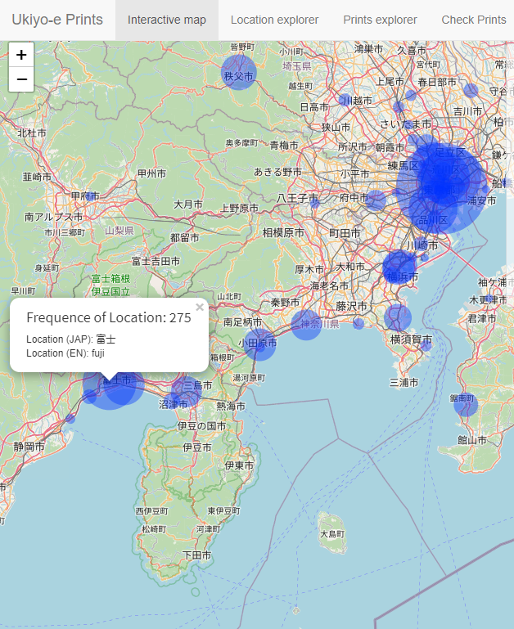
Application
MAP Exploratory
20,408 prints with inscriptions
PLACEs are system-tagged
Lat/Lon extracted per found PLACE
Each is mapped (radio~frequency)
Notes:
We used a best-performing fine-tuned BERT model in order to tag all the place-name entities mentioned within image content-related inscriptions printed on around 20,000 prints. The place-names were pinned on a map. The size of each pin reflects the frequency of a given place-name.

Slide 14
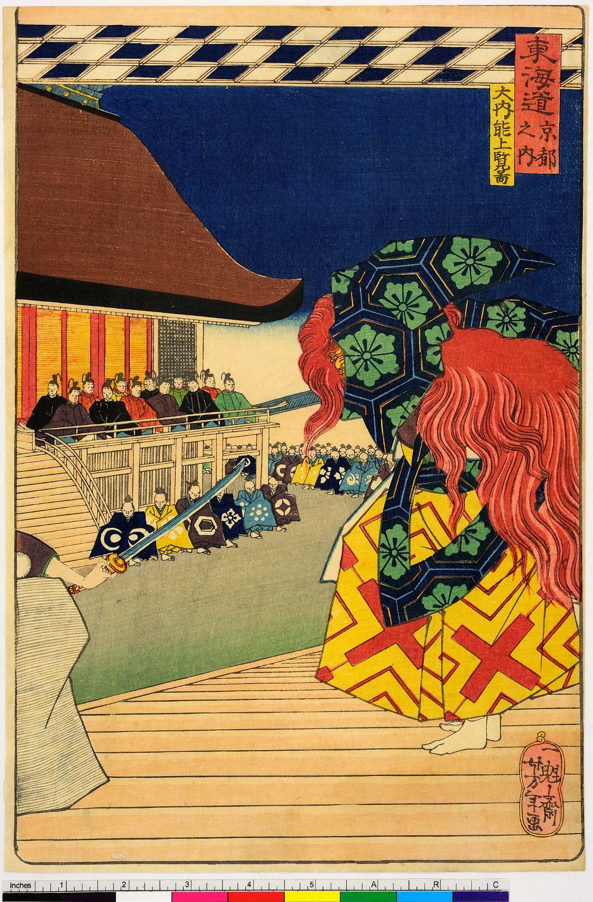
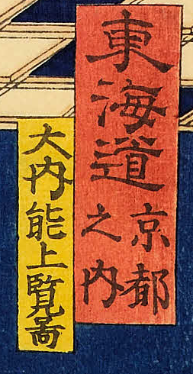

Application: from small to large scale
Cartouche extraction
HTR output Human transcribed
Red : 東海道京都 東海道 京都之内
Yellow : 大内・能上首都市 大内能上覧図
HTR
NER
東海道京都 大内・能上首都市
Kyoto
Kokusho Sōmokuroku (400k+ 90% pre-modern Edo books)
Less than 1% have been transcribed
Notes:
[Painting ID: arcUP0542]
(Ewa says: There [are] a lot of prints without transcriptions in metadata. Also, existing transcriptions are often erroneous or partially missing.)
Applying HTR on ukiyo-e prints will not only enrich, in principle, our primary source of data, allowing a larger scale exploration, but it can also unlock related applications. For example:
The archive of Japanese pre-modern printed books is extremely rich. Kokusho Sōmokuroku (General Catalog of National Books) alone includes more than 450,000 pre-modern books (Morisue et al. 1963), 90% dated to the Edo period (1600-1868). However, only less than 1% of these books have been transcribed. This is mainly due to the inaccessibility of the pre-modern writing system for contemporary Japanese.
In specific, we plan to train HTR models on images and transcriptions of inscriptions on ukiyo-e prints, and then try to automatically transcribe, and potentially also apply NER, on printed books such as those listed in Kokusho Sōmokuroku.
Nakano Mitsutoshi estimates that ‘less than ten percent of the faculty members can read kuzushiji (Nakano 2011)’.

Slide 15
Takeaways
NER on inscriptions of ukiyo-e can facilitate art history
HTR on ukiyo-e prints can automate transcription
NER on HTRed output can increase the scale of our study
Notes:
With this presentation we showed how NLP, specifically NER, can be used to facilitate the study of ukiyo-e prints.
We investigated the performance of HTR on ukiyo-e prints, which can automate the transcription of the print inscriptions, and we highlighted the existing challenges.
Then, by applying NER on the HTRed output, we presented our roadmap toward increasing the scale of our study. A positive outcome will not only allow more diverse results, using more prints, but will also assist HTR on other resources.

Slide 16
Thank you!
Comments

Slide 17
Dataset development
Over 20,408
200
469
Ukiyo-e prints
Annotated by an art historian,
expert in Japanese early modern history.
Place names in the print inscriptions
Notes:
From the around 20,000 digitized prints which arose from our search based on the keyword ‘meisho’ (famous place) and ‘meisho-e’ (image of a famous place), we randomly selected 200 samples to annotate and use them to train and test machine learning algorithms to extract place-name entities. An art historian, an expert in Japanese early modern history annotated two sets of images (100 images each) identified through random sampling and after annotation we identified 469 place names tags.

Slide 18
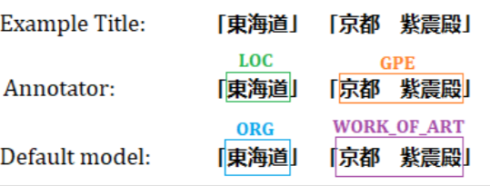
Evaluation metrics
 | Precision | Recall | F1-score
 | SPACY BERT | SPACY BERT | SPACY BERT
GPE | 0.39 0.73 | 0.44 0.74 | 0.41 0.74
LOC | 0.59 0.59 | 0.50 0.50 | 0.54 0.54
Table: Evaluation of SpaCy and BERT NER with Precision, Recall and F1-score at the named entity level, on 100 instances. In bold is the best F1-scores.
Fine-tuning BERT with PLACE labels F1-score increases to 78%
Notes:
For geopolitical entities, however, BERT outperformed Spacy, achieving a balanced performance between Precision and Recall, and a 74% F1-score. Spacy, on the other hand, had a high Precision but very low Recall, leading to an F1-score of 41%.
Error analysis revealed that the entities were detected in the text, but their tag was often misclassified, which might be explained by the very low agreement for the location tag. But the agreement increased when we merged the tags. Doing the same for the computational experiments, merging the two labels into a single PLACE entity tag, and re-training our best performing BERT, showed that the F1 score increased by four units.
Thus, we Fine-tune the BERT with PLACE labels and F1-score increases to 78%.

Slide 19
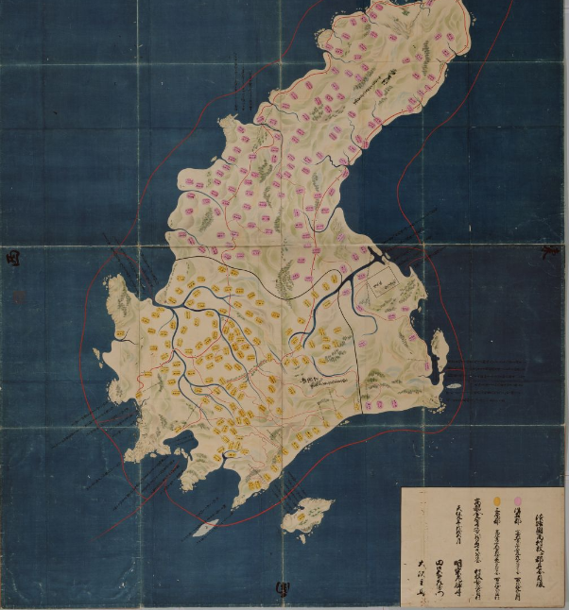
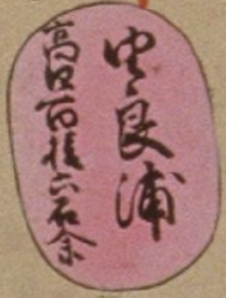
Old Maps
HTR output:
ゆと段階に高校で撮ってきた
Next steps:
- gazetteer from the locations
- select some specific maps
- extract cartouches
Awaji-no-Kuni

Slide 20



Limitations
• BERT NER model, fine-tuned on our dataset, can provide means for ’distant viewing’ of prints. However, the model makes mistakes (e.g.includes places outside Japan).
• Only a single place-name tag (PLACE) was used by our BERT-NER.
• The dataset comprises only 200 instances, but more annotations can lead to more accurate models.
Future work
• Expand our dataset with more inscriptions, as well as with entity types.
• Undertake a spatiotemporal study of ukiyo-e landscape prints and investigate the benefits of NLP-fuelled ‘distant viewing’ by integrating the dimension of time in our analysis.
Conclusion
• Japanese BERT-based NER model can achieve a promising performance.
• Use-case of how can a distant viewing of a visual dataset be undertaken for facilitating research in art history.
Notes:
Some limitations of our approach include:
Although a BERT NER model, fine-tuned on our dataset, can provide a means for `distant viewing', as shown in the map, mistakes and noise is expected to be included in this view (e.g. places located outside Japan);
Only a single place-name tag, PLACE, was used by our NER model because GPE and LOC were merged into a single entity type. However, a bigger dataset could allow analysis using a much more fine-grained resolution;
Our released dataset comprises only 200 instances, but more annotations can lead to more accurate recognition.
Conclusions
In this paper we presented results of the first-step of an analytical process aimed at the investigation of the relationship between topography and its visual renderings in early modern Japanese ukiyo-e landscape prints. Due to the complexity of the question and research material at hand we applied Named Entity Recognition (NER), an NLP technique, to detect place-names featured in the inscriptions of prints hosted by the digital database of the Art Research Center at the Ritsumeikan University. We proposed an approach to generate labeled data to facilitate ‘distant viewing’ or macroanalysis of visual datasets needed to assist art historical studies of this complex research material.
Main takeaways:
we presented a dataset of ukiyo-e landscape prints, with place-names in the inscriptions on the prints annotated by an art historian. This dataset is released for public use.
We showed that a Japanese BERT-based NER model can achieve a promising performance by unlocking useful applications.
We experimented with one such use case, regarding how can a distant viewing of such a visual dataset be undertaken with NER, as a step towards facilitating research in art history.
Future work
Future work includes expansion of our dataset with more inscriptions, as well as with entity types.
Also, by integrating the dimension of time in our analysis, we will attempt to undertake a spatiotemporal study of ukiyo-e landscape prints and investigate other benefits of NLP-fueled ‘distant viewing’ of prints.

Slide 21
Appendix

Slide 22
Annotator: 「東海道五十三次の内」 「戸塚藤沢間」「吉田橋」「松若」
GeoLOD: 「東海道五十三次の内」 「戸塚藤沢間」「吉田橋」「松若」
The excluded places that appear in the title:
Correct not annotate (from GeoLOD) {'Tōkaidō'} 東海道
Problem of evaluation score: Tōkaidō included in annotation
Notes:
Some limitations of our approach include:
Although a BERT NER model, fine-tuned on our dataset, can provide a means for `distant viewing', as shown in the map, mistakes and noise is expected to be included in this view (e.g. places located outside Japan);
Only a single place-name tag, PLACE, was used by our NER model because GPE and LOC were merged into a single entity type. However, a bigger dataset could allow analysis using a much more fine-grained resolution;
Our released dataset comprises only 200 instances, but more annotations can lead to more accurate recognition.
Conclusions
In this paper we presented results of the first-step of an analytical process aimed at the investigation of the relationship between topography and its visual renderings in early modern Japanese ukiyo-e landscape prints. Due to the complexity of the question and research material at hand we applied Named Entity Recognition (NER), an NLP technique, to detect place-names featured in the inscriptions of prints hosted by the digital database of the Art Research Center at the Ritsumeikan University. We proposed an approach to generate labeled data to facilitate ‘distant viewing’ or macroanalysis of visual datasets needed to assist art historical studies of this complex research material.
Main takeaways:
we presented a dataset of ukiyo-e landscape prints, with place-names in the inscriptions on the prints annotated by an art historian. This dataset is released for public use.
We showed that a Japanese BERT-based NER model can achieve a promising performance by unlocking useful applications.
We experimented with one such use case, regarding how can a distant viewing of such a visual dataset be undertaken with NER, as a step towards facilitating research in art history.
Future work
Future work includes expansion of our dataset with more inscriptions, as well as with entity types.
Also, by integrating the dimension of time in our analysis, we will attempt to undertake a spatiotemporal study of ukiyo-e landscape prints and investigate other benefits of NLP-fueled ‘distant viewing’ of prints.

Slide 23
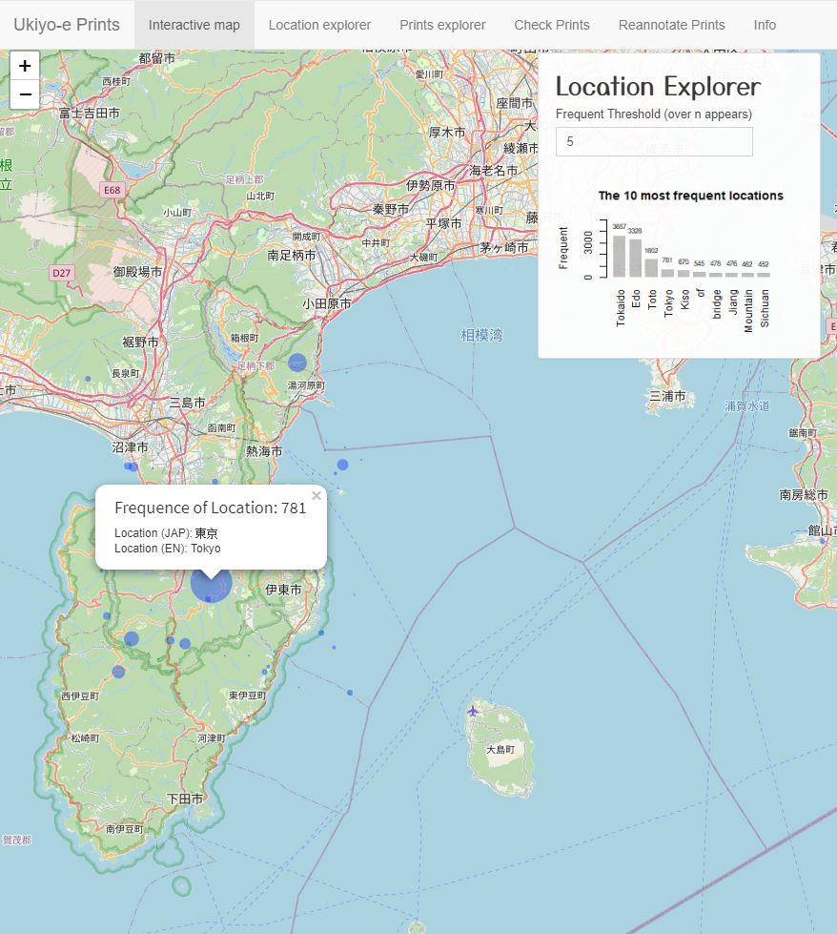
Application
MAP Exploratory
We used the best-performing fine-tuned BERT model in order to tag all the place-name entities mentioned within image content-related inscriptions printed on 20,408 prints. The place-names are pinned on a map. The size of each pin reflects the frequency of a given place-name.
Notes:
We used a best-performing fine-tuned BERT model in order to tag all the place-name entities mentioned within image content-related inscriptions printed on around 20,000 prints. The place-names were pinned on a map. The size of each pin reflects the frequency of a given place-name.

Slide 24
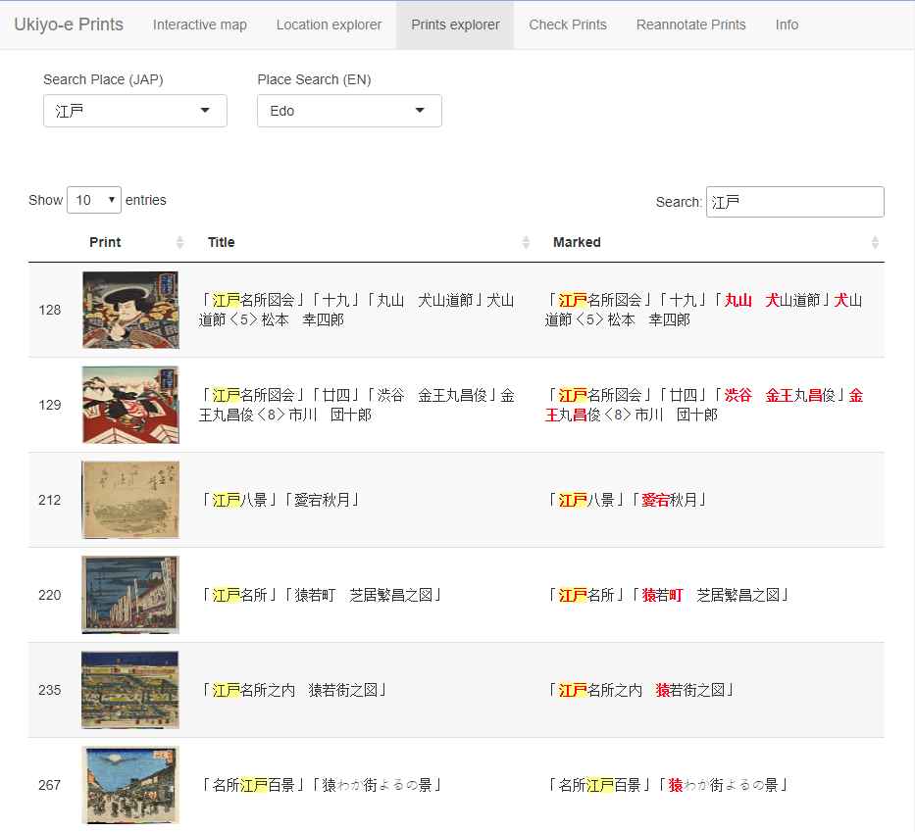

Application
NER Exploratory

Slide 25
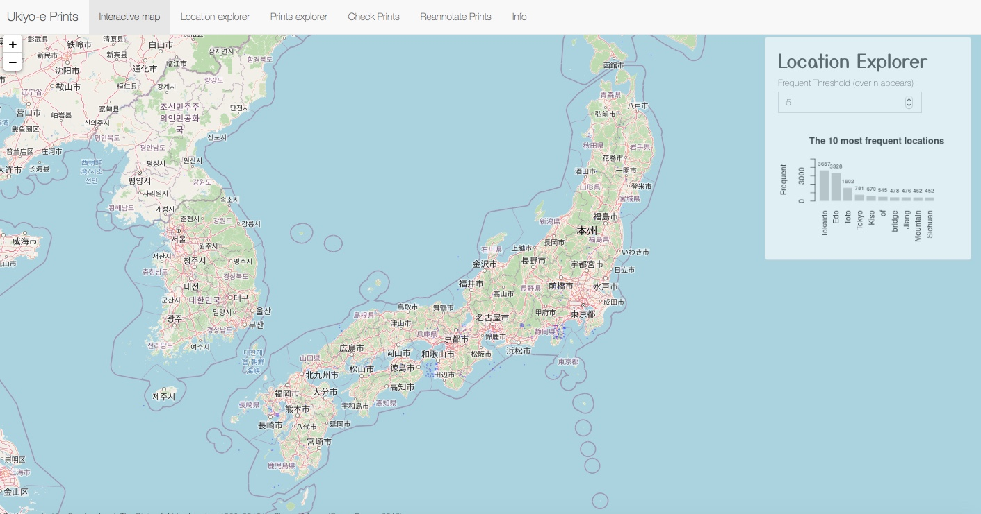
Application: Representation and geolocation of places depicted in prints

Slide 26
Application
NER Exploratory

Slide 27
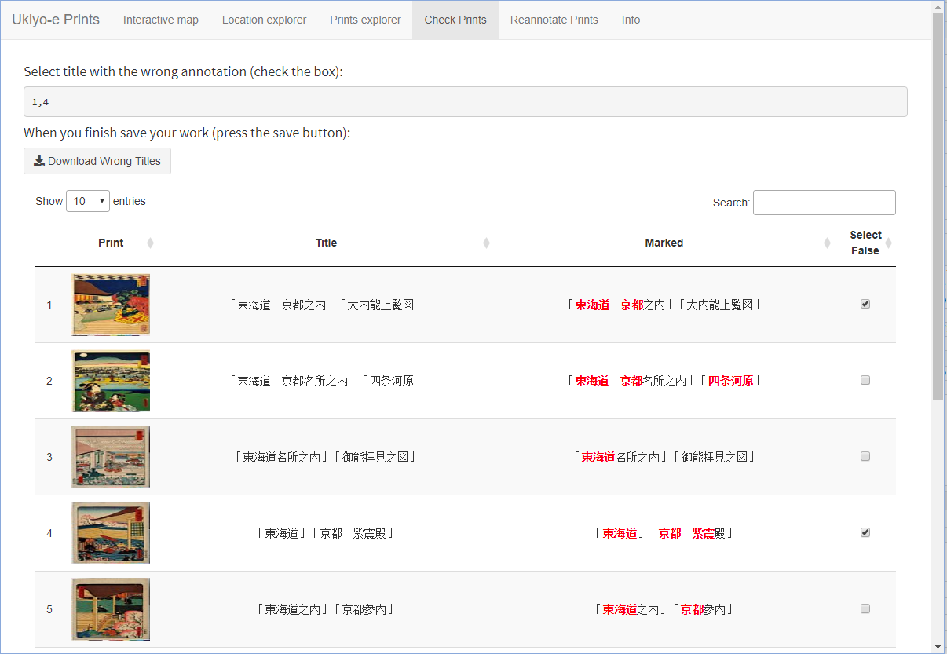
Application
Annotators

Slide 28
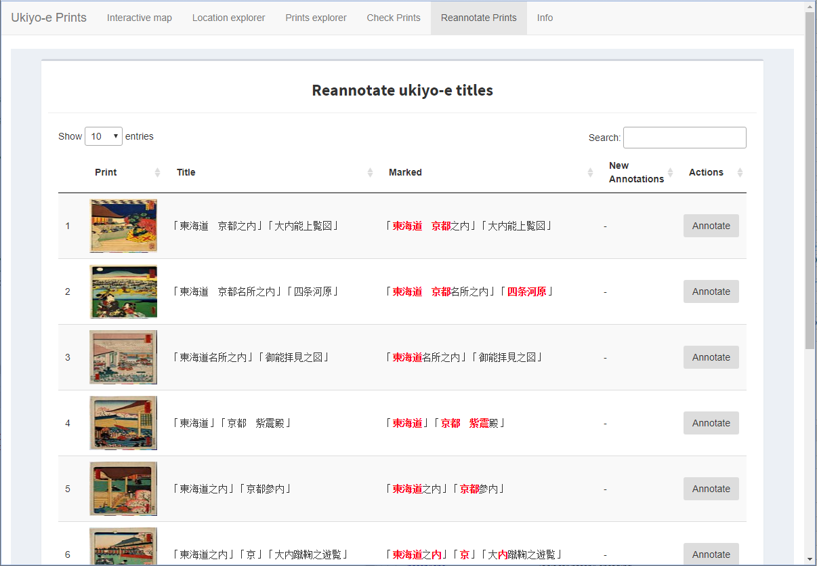
Application
Annotators

Slide 29
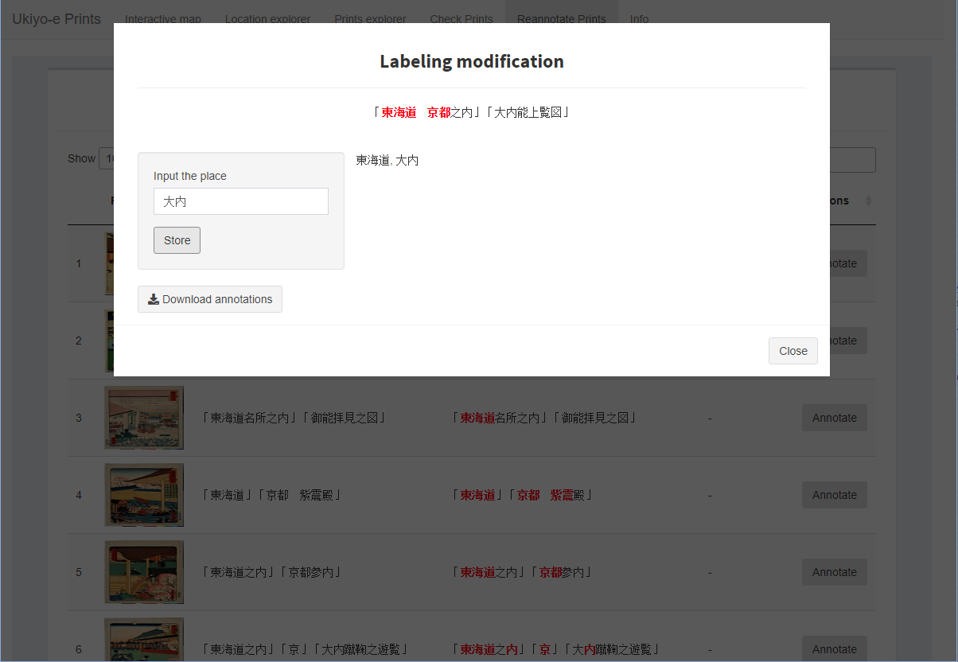
Application
Annotators

Slide 30
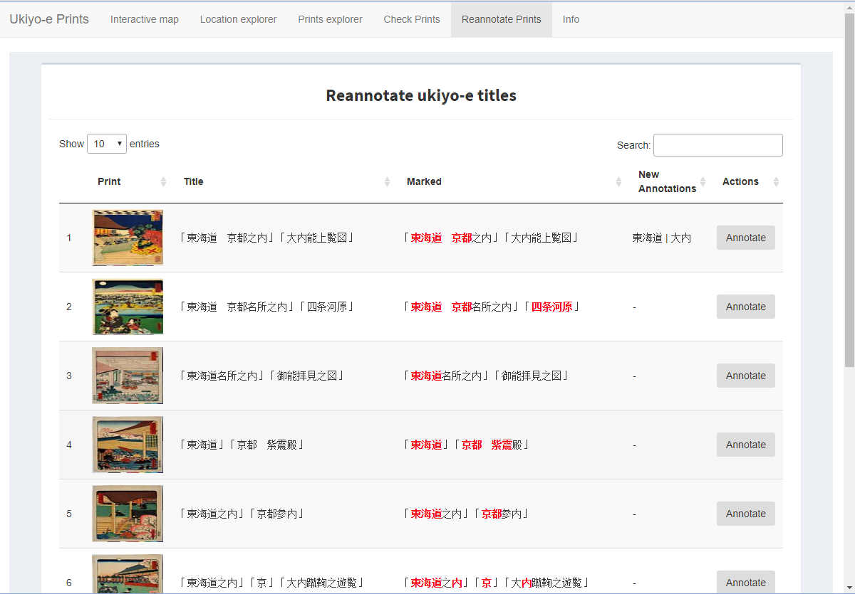
Application
Annotators
xfghfghn

Slide 31
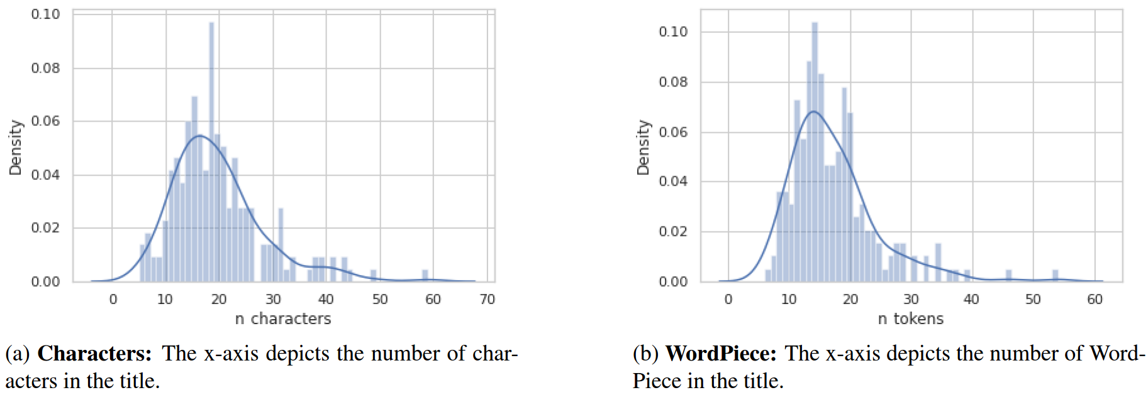
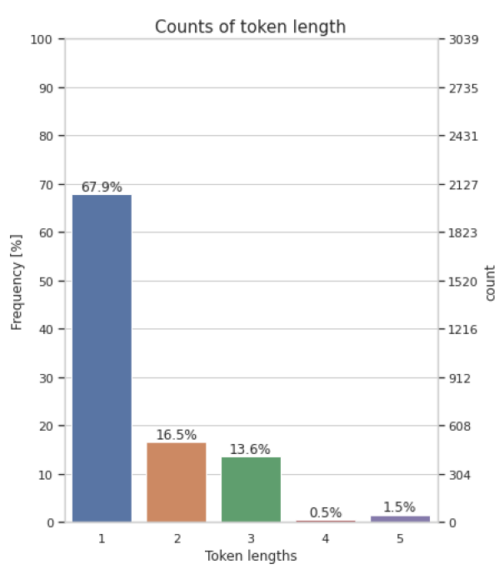
Dataset development
 | Avg | Min | Max
tags per title | 2.33 | 1 | 11
characters per GPE tag | 2.62 | 1 | 8
characters per LOC tag | 2.93 | 2 | 5
cartouches per title | 2.50 | 1 | 11
character tokens per title | 19.68 | 5 | 59
WordPiece tokens per title | 17.17 | 6 | 54
length per token | 1.52 | 1 | 5
Table: Ukiyo-e prints statistics that count of a number of dimensions
Notes:
click: Here, there are some statistics for ukiyo-e prints that count the average, minimum and maximum of tags and tokens. For instance, around 17 tokens appear in each title, after using WordPiece tokinizer.
The image content-related inscriptions have 19.68 Sino-Japanese kanji characters on average, with minimum 5 and maximum 59.
click: Then to have a more complete picture of the data, we did deep exploratory analysis in the tokens and the characters. As, seen in barplot, the tokens had length from 5 characters to 1 characters, which were the most.
click: The length of the titles, counting in word pieces, follows the normal distribution without a lot of outliers as can be seen in distribution plot with the mean is 17 tokens as we said before.

Slide 32
Evaluation metrics
 | Precision | Recall | F1-score
 | SPACY | SPACY | SPACY
GPE | 0.84 | 0.08 | 0.15
LOC | 0.53 | 0.14 | 0.23
Table: Evaluation of SpaCy ‘default’ and ‘calibrated’ with Precision, Recall and F1-score at the named entity level, on 100 instances. In bold is the best scores.

Slide 33
Evaluation metrics
 | Precision | Recall | F1-score
 | SPACY | SPACY | SPACY
GPE | 0.84 0.39 | 0.08 0.44 | 0.15 0.41
LOC | 0.53 0.59 | 0.14 0.50 | 0.23 0.54
Table: Evaluation of SpaCy ‘default’ and ‘calibrated’ with Precision, Recall and F1-score at the named entity level, on 100 instances. In bold is the best scores.
Fine-tuning SPACY achieve
far better F1-score

Slide 34
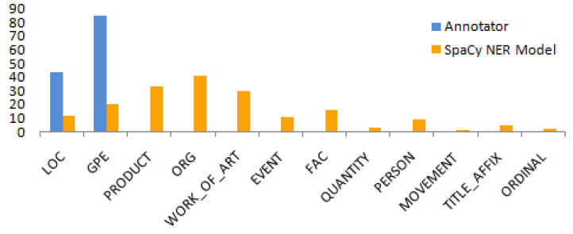
SPACY

Slide 35
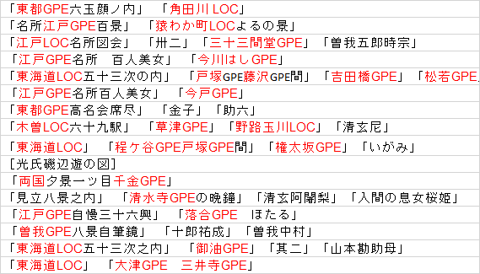

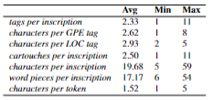
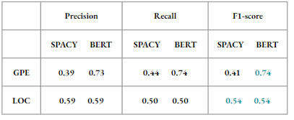
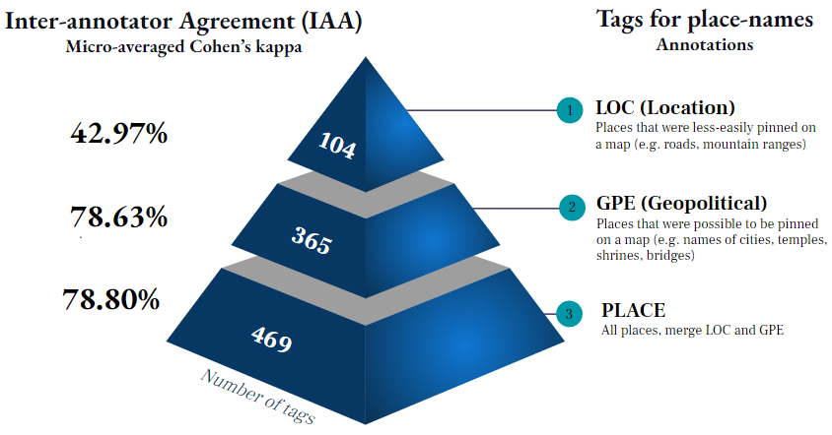
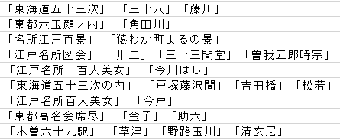
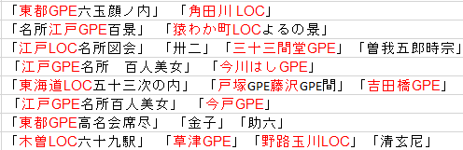
100 Train
Train on 100
…
200 Annotated Inscriptions
100 Test
Named Entity Recognition
Exploratory Data Analysis
Natural Language Preprocessing
Dataset (Ritsumeikan University, Kyoto)
Test on 100
…
subset
Over 20,408
Unlabeled
…
Inference on 20,408
Over 20,408 prints
Application

Slide 36
100 Train
dgvsgv
200 Annotated Titles
100 Test
Over 20,408
Unlabeled
Katsushika Hokusai (1760-1849)
神奈川沖浪裏​​ “Under the Wave off Kanagawa”
from the print series
富嶽三十六景 “Thirty-six Views of Mount Fuji”
ca. 1830–32, MET.

Slide 37
Dataset development
Inter-annotator Agreement (ΙΑΑ)
Micro-averaged Cohen’s kappa
Tags for place-names
Annotations
LOC (Location)
Places that were less-easily pinned on a map (e.g. roads, mountain ranges)
42.97%
1
104
.
GPE (Geopolitical)
Places that were possible to be pinned on a map (e.g. names of cities, temples, shrines, bridges)
78.63%
2
365
78.80%
3
PLACE
All places, merge LOC and GPE
469
 | Precision | Recall | F1-score
 | SPACY BERT | SPACY BERT | SPACY BERT
GPE | 0.39 0.73 | 0.44 0.74 | 0.41 0.74
LOC | 0.59 0.59 | 0.50 0.50 | 0.54 0.54
Number of tags

